Slide 1
Dynamic Programming
Vikram Chaudhary
Technical Blog: www.dotnetforall.com
Twitter: @dotnetforall

Slide 2
Session Contents:
What is Dynamic Programming and why do we need it
Dynamic Programming Simple Example
Understanding and Solving knapsack problem using dynamic programming
Writing a simple algorithm to solve complex problems

Slide 3
Divide and Conquer
Many problems considered superset of smaller problems.
Key concern is to identify and divide a bigger problem into smaller one
Smaller problems can be computed to get the solution
All the solutions can be used to deduce the solution of larger problem

Slide 4
Main Problem ?
Sub Problem ?
Sub Problem ?
Sub Problem ?
Sub Problem ?
Main Solution
Solution
Solution
Solution
Solution

Slide 5
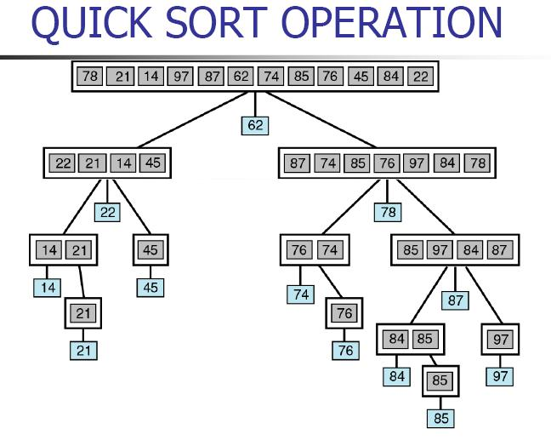

Slide 6
Dynamic Programming
Build on same principle as D & Q.
Unlike D & Q it works on overlapping solutions in recursions
Solutions can be stored as cache.
Can be used while combining the sub-problems
Prevents the explosion of identical sub-problems

Slide 7
?

Slide 8
?
Divide into Sub - Problems

Slide 9
Solve Sub Problems
?
?
?
Divide into Sub - Problems

Slide 10
Solve Sub Problems
?
?
?
!
Divide into Sub - Problems

Slide 11
Solve Sub Problems
?
!
!
!
Divide into Sub - Problems
Solve and Cache results

Slide 12
Solve Sub Problems
!
!
!
!
Divide into Sub - Problems
Get the result from the sub-results
Solve and Cache results

Slide 13
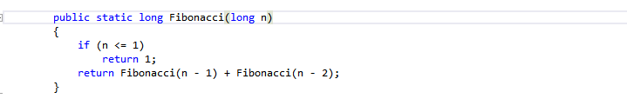

Slide 14
Fibonacci(5)
Fibonacci(4)
Fibonacci(4)
Fibonacci(3)
Fibonacci(3)
Fibonacci(2)
Fibonacci(1)
Fibonacci(3)
Fibonacci(2)
Fibonacci(2)
Fibonacci(1)
Fibonacci(1)
Fibonacci(2)
Fibonacci(1)
Fibonacci(1)
Fibonacci(1)
Fibonacci(0)
Fibonacci(0)
Fibonacci(0)

Slide 15
Fibonacci(5)
Fibonacci(4)
Fibonacci(4)
Fibonacci(3)
Fibonacci(3)
Fibonacci(2)
Fibonacci(1)
Fibonacci(3)
Fibonacci(2)
Fibonacci(2)
Fibonacci(1)
Fibonacci(1)
Fibonacci(2)
Fibonacci(1)
Fibonacci(1)
Fibonacci(1)
Fibonacci(0)
Fibonacci(0)
Fibonacci(0)

Slide 16
Fibonacci for 30
Fibonacci of | Is Computed
1 | 832040
2 | 514229
3 | 317811

Slide 17
Fibonacci With Cache Example
static long[] cache = new long[200];
public static long FibonacciUsingCache(long n)
{
if (n <= 1)
cache[n] = 1;
if (cache[n] == 0)
cache[n] = FibonacciUsingCache(n - 1) + FibonacciUsingCache(n - 2);
return cache[n];
}

Slide 18
Cache Strategy Consideration:
Top Down: The cache was build as recursion progressed
Bottom Up: The cache is build in phase 1 and solution is built in phase 2

Slide 19
The 0/1 Knapsack problem:
Knapsack Capacity: 4
Distinct Items
Items can be present 0 or 1 time.
Items Present
 | Eraser | Pencil | Pen
Weight | 2 | 2 | 1
Value | 3 | 1 | 3

Slide 20
 | 0 | 1 | 2 | 3 | 4
No Item(0)(0) | 0 | 0 | 0 | 0 | 0
Eraser(2)(3) | 0
Pencil(2)(1) | 0
Pen(1)(3) | 0
2 D Array : M[Item + 1][Capacity + 1]

Slide 21
 | 0 | 1 | 2 | 3 | 4
No Item(0)(0) | 0 | 0 | 0 | 0 | 0
Eraser(2)(3) | 0 | 0
Pencil(2)(1) | 0
Pen(1)(3) | 0
If Excluded(E) : m[i-1][Capacity] = 0
If Included & Small Enough(I): value(i) + M[i- 1][capacity - weight]
M[i][Capacity] = max(E, I)

Slide 22
 | 0 | 1 | 2 | 3 | 4
No Item(0)(0) | 0 | 0 | 0 | 0 | 0
Eraser(2)(3) | 0 | 0 | 3
Pencil(2)(1) | 0
Pen(1)(3) | 0
If Excluded(E) : m[i-1][Capacity] = 0
If Included & Small Enough(I): value(i) + M[i- 1][capacity - weight] = 3 + 0 = 3
M[i][Capacity] = max(E, I) = max (0,3) = 3

Slide 23
 | 0 | 1 | 2 | 3 | 4
No Item(0)(0) | 0 | 0 | 0 | 0 | 0
Eraser(2)(3) | 0 | 0 | 3 | 3 | 3
Pencil(2)(1) | 0
Pen(1)(3) | 0
If Excluded(E) : m[i-1][Capacity] = 0
If Included & Small Enough(I): value(i) + M[i- 1][capacity - weight] = 3
M[i][Capacity] = max(E, I)

Slide 24
 | 0 | 1 | 2 | 3 | 4
No Item(0)(0) | 0 | 0 | 0 | 0 | 0
Eraser(2)(3) | 0 | 0 | 3 | 3 | 3
Pencil(2)(1) | 0 | 0
Pen(1)(3) | 0
If Excluded(E) : m[i-1][Capacity] = 0
If Included & Small Enough(I): value(i) + M[i- 1][capacity - weight]
M[i][Capacity] = max(E, I)

Slide 25
 | 0 | 1 | 2 | 3 | 4
No Item(0)(0) | 0 | 0 | 0 | 0 | 0
Eraser(2)(3) | 0 | 0 | 3 | 3 | 3
Pencil(2)(1) | 0 | 0 | 3
Pen(1)(3) | 0
If Excluded(E) : m[i-1][Capacity] = 3
If Included & Small Enough(I): value(i) + M[i- 1][capacity - weight] = 1 + 0 = 1
M[i][Capacity] = max(E, I) = max (3, 1) = 3

Slide 26
 | 0 | 1 | 2 | 3 | 4
No Item(0)(0) | 0 | 0 | 0 | 0 | 0
Eraser(2)(3) | 0 | 0 | 3 | 3 | 3
Pencil(2)(1) | 0 | 0 | 3 | 3
Pen(1)(3) | 0
If Excluded(E) : m[i-1][Capacity] = 3
If Included & Small Enough(I): value(i) + M[i- 1][capacity - weight] = 1 + 0
M[i][Capacity] = max(E, I) = 3,1 = 3

Slide 27
 | 0 | 1 | 2 | 3 | 4
No Item(0)(0) | 0 | 0 | 0 | 0 | 0
Eraser(2)(3) | 0 | 0 | 3 | 3 | 3
Pencil(2)(1) | 0 | 0 | 3 | 3 | 4
Pen(1)(3) | 0
If Excluded(E) : m[i-1][Capacity] = 3
If Included & Small Enough(I): value(i) + M[i- 1][capacity - weight] = 1 + 3 = 4
M[i][Capacity] = max(E, I) = max(3, 4) = 4

Slide 28
 | 0 | 1 | 2 | 3 | 4
No Item(0)(0) | 0 | 0 | 0 | 0 | 0
Eraser(2)(3) | 0 | 0 | 3 | 3 | 3
Pencil(2)(1) | 0 | 0 | 3 | 3 | 4
Pen(1)(3) | 0 | 3
If Excluded(E) : m[i-1][Capacity] = 0
If Included & Small Enough(I): value(i) + M[i- 1][capacity - weight] = 3 + 0 = 3
M[i][Capacity] = max(E, I) = max(0, 3) = 3

Slide 29
 | 0 | 1 | 2 | 3 | 4
No Item(0)(0) | 0 | 0 | 0 | 0 | 0
Eraser(2)(3) | 0 | 0 | 3 | 3 | 3
Pencil(2)(1) | 0 | 0 | 3 | 3 | 4
Pen(1)(3) | 0 | 3 | 3
If Excluded(E) : m[i-1][Capacity] = 3
If Included & Small Enough(I): value(i) + M[i- 1][capacity - weight] = 3 + 0
M[i][Capacity] = max(E, I) = 3, 3 = 3

Slide 30
 | 0 | 1 | 2 | 3 | 4
No Item(0)(0) | 0 | 0 | 0 | 0 | 0
Eraser(2)(3) | 0 | 0 | 3 | 3 | 3
Pencil(2)(1) | 0 | 0 | 3 | 3 | 4
Pen(1)(3) | 0 | 3 | 3 | 6
If Excluded(E) : m[i-1][Capacity] = 3
If Included & Small Enough(I): value(i) + M[i- 1][capacity - weight] = 3 + 3 = 6
M[i][Capacity] = max(E, I) = max(3, 6) = 6

Slide 31
 | 0 | 1 | 2 | 3 | 4
No Item(0)(0) | 0 | 0 | 0 | 0 | 0
Eraser(2)(3) | 0 | 0 | 3 | 3 | 3
Pencil(2)(1) | 0 | 0 | 3 | 3 | 4
Pen(1)(3) | 0 | 3 | 3 | 6 | 6
If Excluded(E) : m[i-1][Capacity] = 4
If Included & Small Enough(I): value(i) + M[i- 1][capacity - weight] = 3 + 3 = 6
M[i][Capacity] = max(E, I) = max(4,6) = 6

Slide 32
 | 0 | 1 | 2 | 3 | 4
Eraser(2)(3) |  |  | 3 | 3 | 3
Pencil(2)(1) |  |  |  |  | 4
Pen(1)(3) |  | 3 | 3 | 6 | 6
If Excluded(E) : m[i-1][Capacity] = 4
If Included & Small Enough(I): value(i) + M[i- 1][capacity - weight] = 3 + 3 = 6
M[i][Capacity] = max(E, I) = max(4,6) = 6

Slide 33
 | 0 | 1 | 2 | 3 | 4
Eraser(2)(3) |  |  | 3 | 3 | 3
Pencil(2)(1) |  |  |  |  | 4
Pen(1)(3) |  | 3 | 3 | 6 | 6
Maximum Possible Value = 6
Items Taken = Pen
Capacity Left = 4 – 1 = 3
Under 3 Capacity Maximum is 6 but Pen is already Taken, in that case we will Take Eraser

Slide 34
Dynamic Programming Practical Example
Conference Track Management

Slide 35
Writing Fast Tests Against Enterprise Rails 60min Overdoing it in Python 45min Lua for the Masses 30min Ruby Errors from Mismatched Gem Versions 45min Common Ruby Errors 45min Rails for Python Developers lightning Communicating Over Distance 60min Accounting-Driven Development 45min Woah 30min Sit Down and Write 30min Pair Programming vs Noise 45min Rails Magic 60min Ruby on Rails: Why We Should Move On 60min Clojure Ate Scala (on my project) 45min Programming in the Boondocks of Seattle 30min Ruby vs. Clojure for Back-End Development 30min Ruby on Rails Legacy App Maintenance 60min A World Without HackerNews 30min User Interface CSS in Rails Apps 30min

Slide 36
Problem Rules:
The conference has multiple tracks each of which has a morning and afternoon session. * Each session contains multiple talks. * Morning sessions begin at 9am and must finish by 12 noon, for lunch. * Afternoon sessions begin at 1pm and must finish in time for the networking event. * The networking event can start no earlier than 4:00 and no later than 5:00.

Slide 37
References:
https://app.pluralsight.com/library/courses/algorithmics-introduction/table-of-contents
https://dzone.com/articles/knapsack-problem

